Slide 1






.
Qt u nastavi
Kontrole
i
razmeštaji
Notes:
The lecture is on widgets and layouts. The idea is to introduce the concepts of widgets and layouts and show how they fit together when creating designs.
Recommended reading before the lecture:
http://doc.trolltech.com/4.6/widgets-and-layouts.html and onwards (follow the link labelled “Next:” at the bottom of each page)

Slide 2

Komponente korisničkog interfejsa
Korisnički interfejs se pravi pomoću pojedinačnih kontrola (widget)
46 kontrola u Designer-u
59+ klasa za kontrole direktno izvedenih iz QWidget klase
QLabel
QScrollBar
QLineEdit
QPushButton
QDoubleSpinBox
Notes:
There are many widgets in Qt, and you can add even more.
59+ descendants from QWidget means that there are more than 59 widgets. For instance QAbstractButton inherits QWidget and result in five different buttons (push, radio, check, toolbar and command).

Slide 3
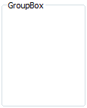
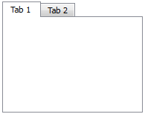
Ugnježdavanje kontrola
Kontrole se uređuju u hijerarhiju korišćenjem kontejnerskih klasa
QGroupBox
QTabWidget
Notes:
Just placing widgets randomly does not help the user much. To structure the interface, a number of container widgets are available.
They provide a visual structure, as well as a functional structure. For instance, radio buttons are mutually exclusive within their specific container.

Slide 4
Osnovne odlike kontrola
Zauzimaju pravougaonu oblast na ekranu
Primaju događaje od ulaznih uređaja
Emituju signale pri odgovarajućim promenama
Hijerarhijski su uređene
Mogu da sadrže druge kontrole
Notes:
What is a widget?
A widget occupies a rectangular area of the screen. It sits there and waits for events (user input...)
It reacts to these events, and if anything notable happens (a text changes, an item is selected, a button is clicked) it emits a signal.
As said on the previous slide, they are structured in a hierarchy (parent-child) and can contain other widgets.

Slide 5

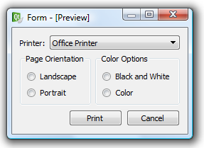
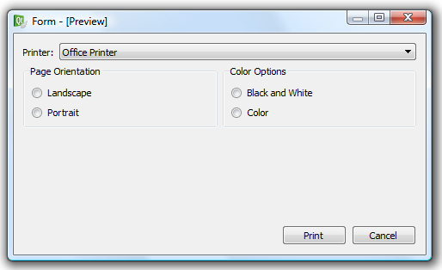
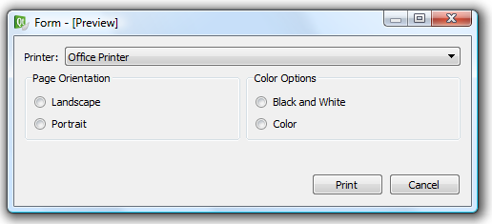
Primer dijaloga
Kontrole se postavljaju u razmeštaje (layouts) kako bi se obezbedila elastičnost korisničkog interfejsa
Notes:
An example dialog – letting the user pick a printer and decide some settings about the resulting output.
Widgets can be placed statically, but the Qt way is to place them in layouts. Layouts let the widgets stretch and move about to fill the available screen estate.
The interface becomes elastic

Slide 6
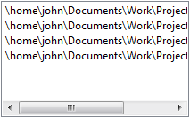
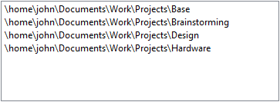



Zbog čega je važno obezbediti elastičan korisnički intefejs?
Dozvoljava da se kontrole prilagode sadržaju
Dozvoljava da se kontrole prilagode prevodima
Dozvoljava da se kontrole prilagode korisničkim podešavanjima
Notes:
Why is elastic good?
For instance, contents, a list of long file names in a too narrow list box. Everything can be seen when it is stretched.
When translating the interface, short words such as “news” can become long, such as “nyheter” (Norwegian). Letting the buttons stretch avoids truncation of the contents.
When the user changes settings, such as font sizes, a elastic interface allows the widgets to respect this.

Slide 7



Razmeštaji (layouts)
Postoji nekoliko dostupnih razmeštaja
Razmeštaji i kontrole “pregovaraju” o veličini i položaju
Razmaci (spacer springs) se mogu upotrebiti da popune praznine
QHBoxLayout
QVBoxLayout
QGridLayout
Notes:
There are a number of available layouts.
The images show (left to right): vertical box, horizontal box and grid.
Layouts and widget negotiate for sizes and positions to determine the final size and location of each widget
To fill out voids (for instance, to push the buttons right in the previous slide) spacer springs can be used.

Slide 8
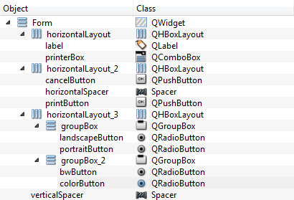
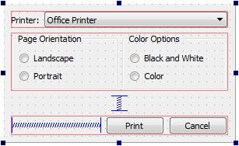
Primer dijaloga
Dijalozi se pravi pomoću više nivoa razmeštaja i kontrola
Notes:
Returning to the example dialog, we can see how the hierarchy of widgets and the actual layout sticks together. (explain the images above)
The next slide will show the dialog as code.

Slide 9

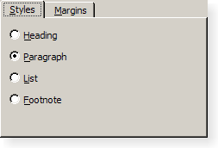
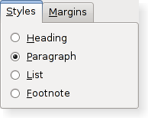
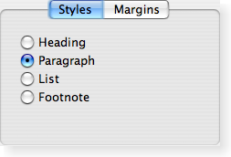
Različiti stilovi za različite platforme
Kontrole se crtaju platformski specifičnim stilovima da bi se obezbedio “native” izgled.
Notes:
As Qt is a cross platform tool, all widgets are drawn with a native look using a style.
There are numerous styles – and for KDE there are even more. For KDE, styles are a part of the tweakability of the desktop itself.

Slide 10

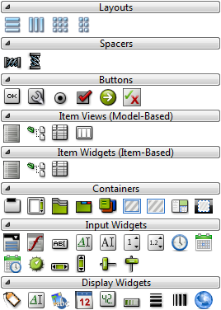
Osnovne kontrole
Qt poseduje određen broj osnovnih kontrola koje su dostupne iz Designer-a
Podeljene su u grupe radi boljeg pregleda
Notes:
There are many widgets in Qt, so one issue is to be able to pick the right one for the right task.
Designer (a part of QtCreator) has a nice grouped list of some of the available widgets.
Continues, looking through some of each group

Slide 11
Osnovne kontrole:
Dugmići
Svi dugmići nasleđuju osnovnu klasu QAbstractButton.
Signali
  clicked() – emituje se kad korisnik klikne na dugme.
  toggled(bool) – emituje se kada se promeni stanje uključenosti dugmeta.
Svojstva
  checkable – true ako se dugme može uključivati i isključivati.
  checked – true kada je dugme uključeno.
  text – tekst koji se ispisuje unutar dugmeta.
  icon – ikonica koja se prikazuje na dugmetu (može se prikazivati zajedno sa tekstom).
QAbstractButton
QPushButton
QCheckBox
QRadioButton
Notes:
Buttons are one of the key components in user interfaces.
All buttons in Qt inherit the abstract button class. This class defines signals such as clicked, toggled and properties such as checkable, text and icon.
Check boxes and radio buttons are checkable by default, while an ordinary push button needs to be made explicitly checkable (makes it toggle, sticking “down”)
Continues

Slide 12
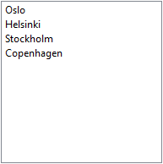

Osnovne kontrole:
Kontrole sa stavkama
QListWidget se koristi za prikaz liste stavki
Dodavanje stavki
  addItem(QString) – dodaje stavku na kraj liste
  insertItem(int row, QString) – dodaje stavku na određeno mesto
Selekcija
  selectedItems – vraća listu QListWidgetItem-a. Za dobijanje teksta stavke koristi se QListWidgetItem::text
Signali
  itemSelectionChanged – emituje se pri promeni selekcije
QComboBox prikazuje listu sa jednostrukom selekcijom na kompaktniji način.
QListWidget
QComboBox
Notes:
There are three general types of item views in Qt: lists, tables and trees. For now, we'll stick to the lists.
Using a list widget, you have a list to which you can add and insert items
You can get a list of selected list widget items, and using the text property on those items, you can determine what is selected
You can listen to the itemSelectionChanged signal if you want to react to changes in selections
For a more compact dialog design, you can use a combo box to let the user pick one item from a list.
Continues

Slide 13

Osnovne kontrole:
Kontejneri
Kontejnerske kontole se koriste za struktuiranje korisničkog interfejsa
Obično su pasivni elementi interfejsa
Običan QWidget se može koristiti kao kontejner
Designer: Postaviti kontrole u kontejner i primeniti neki razmeštaj nad kontejnerom
Kod: Kreirati razmeštaj za kontejner i dodati kontrole u razmeštaj
QGroupBox
QGroupBox *box = new QGroupBox();
QVBoxLayout *layout = new QVBoxLayout(box);
layout->addWidget(...);
...
QTabWidget
QFrame
Notes:
Container widgets are there to provide structure to the user interfaces – but also to group functionally (radio buttons)
For now, we can look at container widgets as purely passive players. That is, place and layout them.
When using Designer, the recommended approach is to populate the containers, then apply a layout to the containers.
When using code, create a layout with the container as parent, then add widgets to the layout.
Continues

Slide 14
Osnovne kontrole:
Kontrole za unos podataka
Za unos jednolinijskog teksta se koristi QLineEdit
Signali:
  textChanged(QString) – emituje se kada dođe do promene teksta u kontroli
  editingFinished() – emituje se kada kontrola izgubi fokus
  returnPressed() – emituje se kada se pritisne taster return
Svojstva
  text – tekst sadržan u kontroli
  maxLength – maksimalna dužina teksta koja može da se unese
  readOnly – da li je dozvoljeno menjanje teksta
QLineEdit
Notes:
The input widgets are interesting, so we will spend some extra time on them. One of the most common is the line edit. It is a text editor for single line, plain text, entries
Signals: textChanged, but also editingFinished and at times returnPressed
Important properties: text, maxLength and readOnly
Remember, if you have a read only line edit, the user can still copy its contents, that is not possible with an ordinary label.
Continues

Slide 15
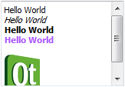
Osnovne kontrole:
Kontrole za unos podataka
Za višelinijski unos teksta se koriste QTextEdit ili QPlainTextEdit
Signali
  textChanged() – emituje se kad se tekst promeni
Svojstva
  plainText – ne formatirani tekst
  html – HTML formatirani tekst
  readOnly – da li je moguće menjati tekst
QComboBox može postati editabilan ukoliko se postavi editable svojstvo
Signali
  editTextChanged(QString) – emituje se kada se promeni tekst
Svojstva
  currentText – tekući tekst u edit delu combo box-a
QTextEdit
QComboBox
Notes:
For more advanced text input (multi-line or formatted texts) you can use a text edit, or a plain text edit widget.
Signals: text changed
Properties: plainText (probably most interesting right now) and html (with formatting). These controls can also be made read only for showing documents, etc.
The combo box, shown in the list slide, can be made editable. Then the currentText property is of use.
Continues

Slide 16

Osnovne kontrole:
Kontrole za unos podataka
Za unos i ažuriranje celobrojnih vrednosti na raspolaganju stoji veliki broj kontrola
Postoje i kontrole za unos realnih brojeva, vremena i datuma
Signali
  valueChanged(int) – emituje se pri promeni vrednosti
Svojstva
  value – tekuća vrednost
  maximum – minimalna vrednost
  minimum – maksimalna vrednost
QAbstractSlider
QSpinBox
QDial
QScrollBar
QSlider
Notes:
It can be tempting to use a line edit widget to get integer values from users, but it is better to use a widget aware of the task.
There are a set of slider widgets (inheriting abstract slider), but also the spin box that exposes the same signals and properties.
All these widgets have minimum, maximum and value properties along with a valueChanged signal.
There are (other) widgets for floating point values, dates and time.
Continues

Slide 17

Osnovne kontrole:
Kontrole za prikaz podataka
Za prikaz teksta ili slika koristi se QLabel kontrola
Svojstva
  text – tekst koji se prikazuje
  pixmap – slika koja se prikazuje
QLCDNumber se koristi za prikaz celobrojnih vrednosti
Svojstva
  intValue – celobrojna vrednost koja se prikazuje (postavlja se korišćenjem metoda display(int))
QLabel
QLabel
QLCDNumber
Notes:
The last group of widgets are the passive display widgets. This group contains what must be one of the most common widgets of all categories: the label.
A label widget can display an image, or a text. Use setText and setPixmap to assign a look to it.
A less common, but useful, widget is the LCD number. It reflects the integer input widgets well, and displays a value. Use the display function to set a value (this is because the widget can display doubles too, setIntValue is the obvious name).

Slide 18
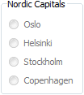
Opšta svojstva kontrola
Sve kontrole poseduju skup osnovnih svojstava koji nasleđuju iz QWidget klase
enabled – da li je kontrola omogućena
visible – da li je kontrola vidljiva ili ne
Ova svojstva se prenose i na ugnježdene kontrole.
Notes:
As all widgets have a common base class, QWidget, they also share a set of properties.
The two most useful are enabled and visible.
Enabled, lets you enable or disable user interaction.
Visible lets you show and hide a widget (alter with the show/hide functions, or setVisible)
These properties also affect child widgets, so you can enable/disable or show/hide whole sections of a user interface. The example image shows a disabled group box with radio buttons. As the buttons are contained, they are automatically disabled.

Slide 19
Smernice za veličinu kontrola
Rezultujući raspored kontrola nastaje u procesu “pregovaranja” između kontrola i razmeštaja
Razmeštaji definišu strukturu
  horizontalne i vertikalne rasporede
  rešetkasti raspored (grid)
Kontrole određuju
  smernice po pitanju veličine (u oba pravca)
  minimalne i maksimalne veličine
Notes:
Earlier it was stated that layouts and widgets negotiate for the screen estate.
Then we mentioned layouts and their role in the game – to provide a structure.
The widgets also bring something – size policies and size limitations
Continues

Slide 20
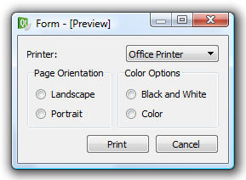
Smernice za veličinu kontrola
printerList->setSizePolicy(QSizePolicy::Expanding, QSizePolicy::Fixed)
Notes:
In the example dialog that we started this lecture with, we cheated. The top dialog is what the code did, but you where shown the bottom one.
What is the difference between the two? In the first case, the label and combo box are equally hungry for space, so they get an equal chunk.
By setting the horizontal size policy of the combo box to Expanding, we make it more hungry. This means that it gets as large as possible, pushing back the label to its smallest possible size.
Continues

Slide 21
Smernice za veličinu kontrola
Svaka kontrola može da definiše sledeće smernice za veličinu po oba pravca:
  Fixed – zadatu veličinu ne treba menjati
  Minimum – zadata je minimalna veličina, kontrola može samo da se povećava
  Maximum – zadata je maksimalna veličina, kontrola može samo da se smanjuje
  Preferred – zadata je poželjna veličina uz mogućnost izmene
  Expanding – zadata je poželjna veličina sa tendencijom povećanja
  MinimumExpanding – zadata je minimalna veličina sa tendencijom povećanja
  Ignored – nema smernice
Notes:
Which size policies are available? All widgets provide a size hint based on their contents. From this hint, the following policies are available
Remember that policies are set for each direction (vertical and horizontal) so a widget can be expanding horizontally while being fixed vertically
Fixed, Minimum, Maximum, Preferred, Expanding, MinimumExpanding, Ignored
But how are these policies read? Continues

Slide 22




Primeri
Obe kontrole imaju Preferred smernicu
Prva je Preferred, druga je Expanding
Obe su Expanding
Sve tri imaju smernicu Fixed za visinu
Notes:
Widgets that can and/or want to grow equally much get an equal amount of space
Widgets that want to grow next to widgets that only can grow get as much space as possible
When a widget is limited in size and cannot fill its assigned area it is centered (can happen to Fixed and Maximum policies)
Continues

Slide 23
Minimalna i maksimalna veličina
Pored smernica za kontrole je moguće definisati minimalnu i maksimalnu dozvoljenu veličinu
maximumSize – najveća moguća veličina
minimumSize – najmanja moguća veličina
ui->pushButton->setMinimumSize(100, 150);
ui->pushButton->setMaximumHeight(250);
Notes:
The last ingredient in the size negotiation is the widget's size restrictions.
You can set minimum and maximum size for all widgets.
You can even limit one single direction, i.e. setMaximumHeight or setMinimumWidth.

Slide 24
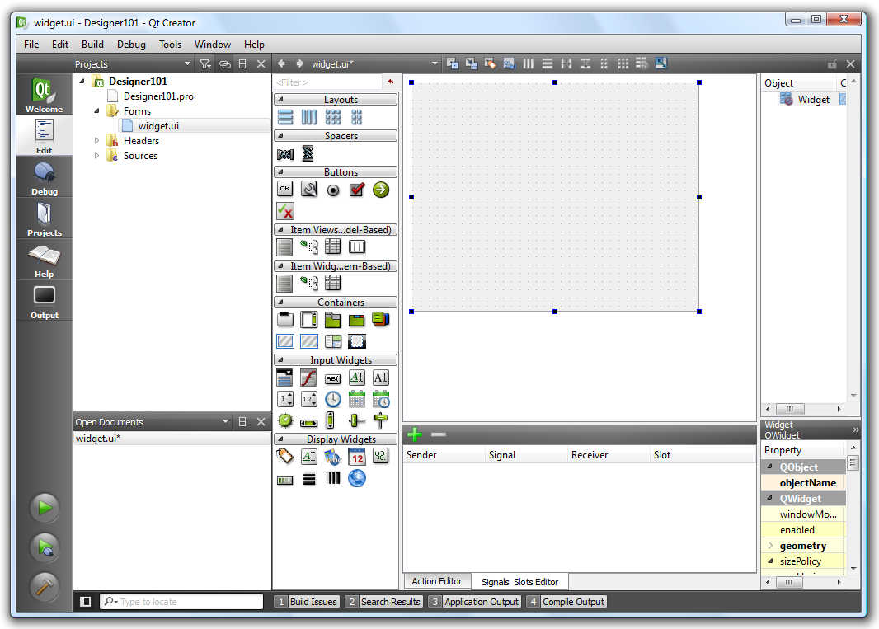
Upoznavanje sa Designer-om
Designer je ranije bio nezavistan alat, a sad je integrisan u QtCreator IDE
Reč je o vizuelnom editoru formi
Kontrole se dodaju prevlačenjem iz palete
Obezbeđuje podešavanje razmeštaja
Obezbeđuje povezivanje signala i slotova
Notes:
Designer is one of the tools that has been shipped with Qt since forever. These days it is an integrated part of Qt Creator, but if you start a command prompt and type designer, it will start.
It is a tool for editing the user interfaces. You can drag and drop widgets, work with layouts and also make signal/slot connections.
Continues

Slide 25
Upoznavanje sa Designer-om
sources
*.cpp
compiles
object files
*.o
links
executables
includes
compiles
headers
*.h
mocs
generated
moc_*.cpp
user interfaces
*.ui
Korisnički interfejs formi se čuva u *.ui fajlovima
Reč je o XML fajlovima
Notes:
User interfaces, forms, are stored as *.ui files. These are XML files describing the interfaces.
Continues

Slide 26
Upoznavanje sa Designer-om
sources
*.cpp
compiles
object files
*.o
links
executables
includes
compiles
headers
*.h
mocs
generated
moc_*.cpp
user interfaces
*.ui
uic
generated
ui_*.h
UI fajlovi se korišćenjem User Interface Compiler-a (uic)
prevode u ui_*.h fajlove
Rezultujući fajlovi se uključuju u *.h ili *.cpp fajlove
Notes:
The ui files are compiled into C++ using the user interface compiler, uic. The resulting files are included into either the source or header files.
Continues

Slide 27
Izgled koda (h fajl)
#ifndef WIDGET_H
#define WIDGET_H
#include <QWidget>
namespace Ui {
class Widget;
}
class Widget : public QWidget {
Q_OBJECT
public:
Widget(QWidget *parent = 0);
~Widget();
private:
Ui::Widget *ui;
};
#endif // WIDGET_H
Deklaracija
Ui::Widget klase
Standardni deo za QWidget nasleđenu klasu
Ui::Widget pointer ui
preko kog se pristupa
kontrolama
Notes:
Looking at the code generated by Qt Creator when creating a designer form class.
The header file.
The class is called Widget, so the result from designer will be Ui::Widget. Here it is forward declared, so the header will be included in the cpp file.
The Widget class defines a basic QWidget-derived class, but includes a Ui::Widget pointer called ui.
The naming is not necessary, but it is convention to use it.
Continues

Slide 28
Izgled koda (cpp fajl)
#include "widget.h"
#include "ui_widget.h"
Widget::Widget(QWidget *parent) :
QWidget(parent),
ui(new Ui::Widget)
{
ui->setupUi(this);
}
Widget::~Widget()
{
delete ui;
}
Instanciranje
Ui::Widget klase
kao ui
Poziv setupUi, kojim se kreiraju sve kontrole kao deca matične kontrole (this).
Brisanje ui
objekta
Notes:
The cpp file implements a constructor and destructor that initializes ui with a new instance of Ui::Widget and deletes it when the Widget instance is destructed.
The constructor calls ui->setupUi(this), this creates the widgets (object instances) as defined in Designer with the this object as the overall parent.

Slide 29
Korišćenje Designer-a
Osnovni tok akcija
  Grubo postavljanje kontrola
  Postavljanje razmeštaja od dublje ugnježdenih kontrola ka glavnoj formi, dodavanje razmaka po potrebi
  Pravljenje veza između signala i slotova
  Korišćenje iz koda
  Kroz ceo ovaj proces je moguće menjati svojstva kontrola
Uz malo vežbe pravljenje formi postaje vrlo jednostavno!
Notes:
Developing software is an iterative process, so you are likely to revise what I say now.
The basic working process when using designer can be divided into four steps.
First, place all widgets.
Second, apply layouts from the inside out, i.e. start with the widgets contained in other widgets and work your way to the top level widget. One could say, layout the leaves of the object tree.
Third, make any connections that you want to have (this can really be done at any time)
Fourth, write the code for the user interface.
Throughout this process, you can alter and edit properties.
Remember that using designer needs practice.
Continues

Slide 30
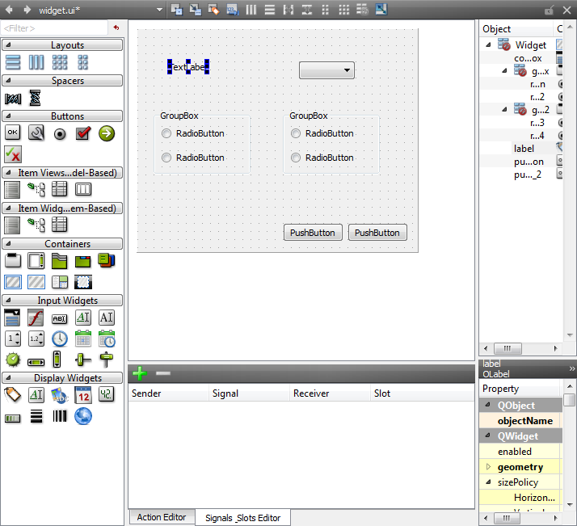
Korišćenje Designer-a
Grubo postavljanje kontrola
drag-and-drop
Notes:
Looking at the process (you can demonstrate this if you like, the target is the example dialog that we started with)
First place the widgets roughly as you want them. Drag them from the widget list to the form.
Continues

Slide 31
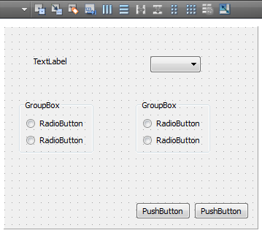
Korišćenje Designer-a
Postavljanje razmeštaja od unutra ka spolja, dodavanje razmaka po potrebi
2
1
1. Selektovanje grupe, 2. Postavljanje vertikalnog razmeštaja
Notes:
Next start applying layouts. The inner-most widgets are the check boxes in the group boxes.
Select each group box and apply a vertical box layout.
Continues

Slide 32
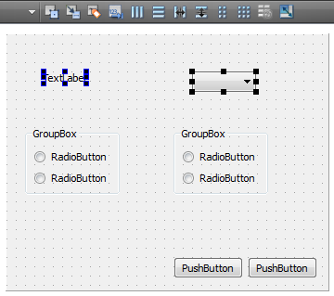
Korišćenje Designer-a
Postavljanje razmeštaja od unutra ka spolja, dodavanje razmaka po potrebi
1
2
1. Selektovanje labele (klik), 2. Selektovanje combo box-a (Ctrl+klik)
Notes:
The next level of layouts will be each row of the main dialog.
Select the widgets on each row (label + combo) using clicks and ctrl+click.
Continues

Slide 33
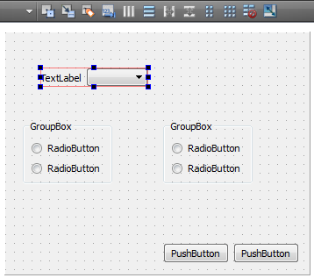
Korišćenje Designer-a
Postavljanje razmeštaja od unutra ka spolja, dodavanje razmaka po potrebi
1
1. Postavljanje horizontalnog razmeštaja
Notes:
When a full row has been selected, apply a horizontal box layout to them.
Continues

Slide 34
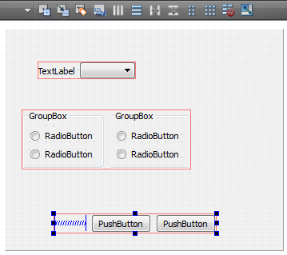
Korišćenje Designer-a
Postavljanje razmeštaja od unutra ka spolja, dodavanje razmaka po potrebi
1
3
2
1. Selektovanje obe grupe i postavljanje horizontalnog razmeštaja
2. Dodavanje horizontalnog razmaka
3. Postavljanje horizontalnog razmeštaja za razmak i dugmiće
Notes:
Do this for the two group boxes as well
For the buttons, we need a spacer to keep them to the right. (The ideal choice would have been to use a dialog button box here, but we will do that in the exercises.)
Add the spacer, select it and the two buttons and lay them out
Continues

Slide 35
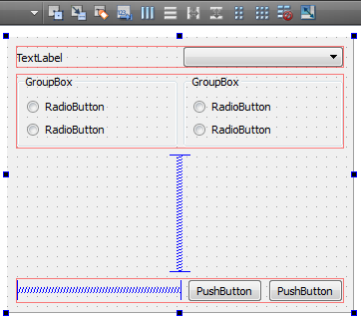
Korišćenje Designer-a
Postavljanje razmeštaja od unutra ka spolja, dodavanje razmaka po potrebi
3
2
1
1. Dodavanje vertikalnog razmaka 2. Selektovanje forme
3. Postavljanje vertikalnog razmeštaja
Notes:
The final step is to add the spacer between the group boxes and buttons (to determine where the dialog is to grow – the alternative would have been stretching group boxes, but that looks bad)
Add the spacer, select the form itself, apply a vertical layout.
If demonstrating, preview using Ctrl+Alt+R (from
Qt Creator).
Continues

Slide 36
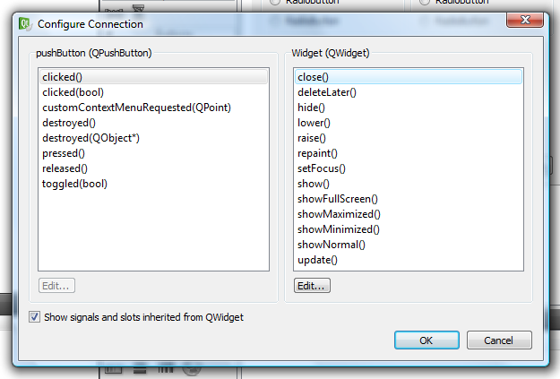
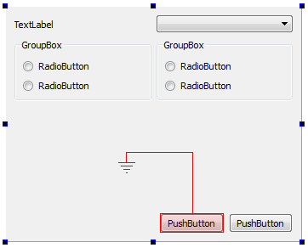
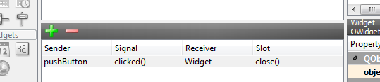
Korišćenje Designer-a
Povezivanje signala i slotova (između kontrola)
1
3
2
4
1. Prebacivanje u mod za povezivanje signala i slotova, 2. Prevući jednu kontrolu na drugu
3. Izabrati signal i slot, 4. Prikaz rezultata u Signal & Slot Edit-u
Notes:
There are two ways to make connections. Either between widgets on the form or between widgets and your code.
When connecting widgets on the form, switch to signal and slot editing mode (toolbar).
Then drag from the source to the destination.
Pick a signal and a slot (the form is a QWidget, so the “include signals and slots inherited from QWidget” check box must be checked)
When a connection has been made you can see it in the connections dock
Continues

Slide 37
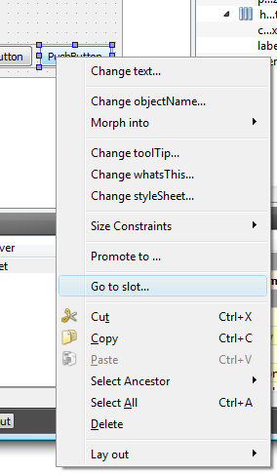
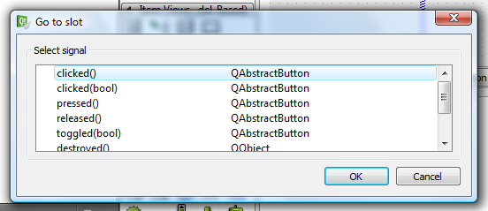
Korišćenje Designer-a
Povezivanje signala i slotova (sa kodom)
1
3
2
1. Koristi se mod za editovanje
2. Iz konteksnog menija (desni klik na kontrolu) izabrati opciju Go to slot...
3. Izabrati signal za koji se želi generisati slot u kodu
Notes:
To make connections from a widget to your code, you need to be in the widget editing mode (toolbar)
Right click on a widget, pick go to slot and pick a signal to react to. This takes you to the corresponding code.
Continues

Slide 38
Korišćenje Designer-a
Pristup kontrolama iz koda
Sve kontrole su dostupne preko ui pokazivača
class Widget : public QWidget {
...
private:
Ui::Widget *ui;
};
void Widget::memberFunction()
{
ui->pushButton->setText(...);
}
Notes:
Finally, you need to write the code for the user interface.
You can access all widgets of the user interface through the ui class member.
All pointers are valid after having called setupUi.

